Slide 1
Break out
Introduce yourself
  Name
  School
  One thing you hope to get out of the summer institute

Slide 2
Kinematics
Mouse Trap Car
Starting from the end and backwards planning…

Slide 3
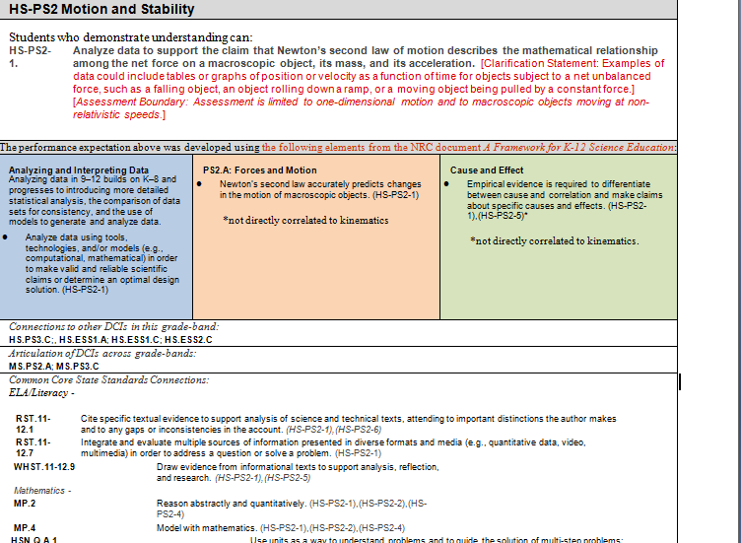
Start with the PE

Slide 5
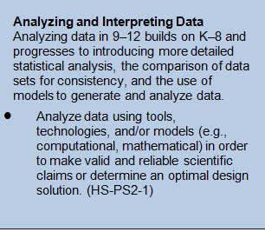

Slide 6
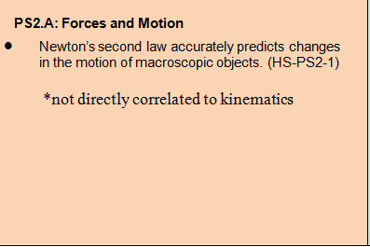

Slide 7
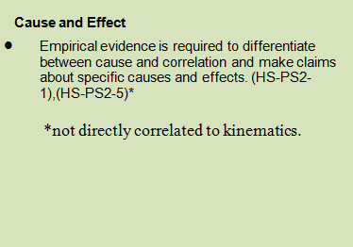

Slide 8
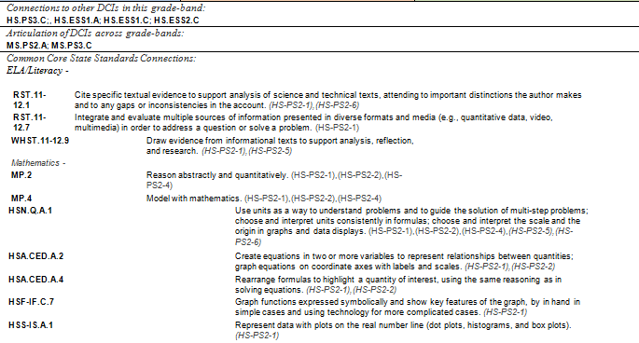

Slide 9
Kinematics
Winding up/Student Walk
Galileo’s Free Fall
Mouse Trap Build
Galileo’s Inclined Plane
Mouse Trap Competition & Video Analysis
Lab Write up
activities
*
*
V = ∆X/∆t
X = 1/2 at^2
Acceleration – non constant Velocity
Building a working car
Analysis using Technology
Articulate scientific thought
conceptual development

Slide 10
Winding up/Student Walk
Quantitative
Students investigate motion
  Predict motion
  What data is needed?
Develop and perform an experiment
Draw conclusion based on evidence
Classroom Discussion

Slide 11
Galileo’s Inclined Plane
Quantitative
Student roll marbles down an inclined plane and gather data
Improve lab skills
Improve graphical analysis
Exploration of accelerating bodies

Slide 12
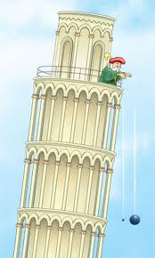
Galileo’s Free Fall
Quantitative
Students drop objects of varying mass (same height)
  Minimal air friction
Exploration of accelerating bodies in “free fall”
Determine acceleration due to gravity

Slide 13
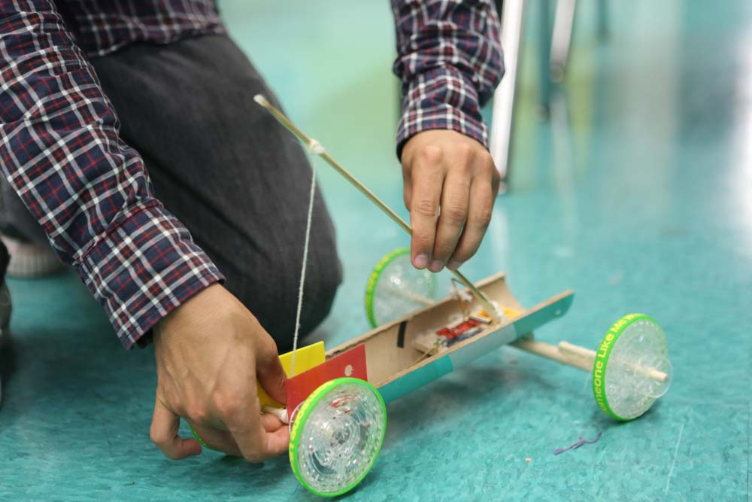
Mouse Trap Car*
Using T4T – No kits allowed!
Use video analysis (technology in the classroom)
Students keep
track of budget
Competition

Slide 14
Video Analysis*
Viewing and moving Frame by Frame
Open Windows Media Player
Click “view” in the tool bar or right click the video
Go to Enhancements
Go to Play Speed Settings
Use the next/back buttons to advance/regress video frame by frame

Slide 15
Lab Write up
Summarize learning
Articulate scientific processes

Slide 16

Activity Time!
Goals
  Construct mouse trap cars (pairs)
  Use video analysis to successfully plot the motion
    find a way to collect the data!

